Slide 1

A Liberal Education
Cambridge dictionary

Slide 2
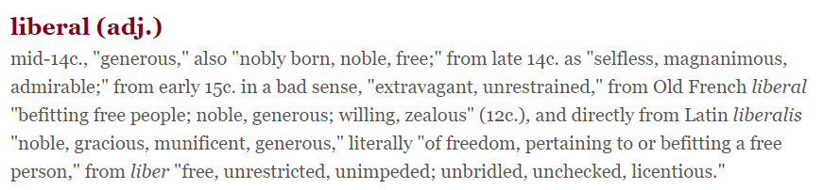

A Liberal Education

Slide 3
A Liberal Education(1868)
England in the mid-19th century
Charles Darwin, The Origin of Species, 1859;
Charles Dickens, Oliver Twist, 1838;
Class divisions – underclass, middleclass, landed gentry(the squires).

Slide 4
A Liberal Education(1868)
England in the mid-19th century
Charles Darwin, The Origin of Species, 1859;
Charles Dickens, Oliver Twist, 1838;
Class divisions – underclass, middleclass, landed gentry(the squires).
The South London Working Men’s College
It was founded in 1868;
T. H. Huxley was its first principal.
It aimed specifically at teaching working people.

Slide 5

T. H. Huxley
He was
a scientist(1825-1895), working on anatomy;
a promoter of education for the masses;
a supporter of Darwin’s evolutionary theory;
Darwin’s bulldog.

Slide 6
Famous quotes
Huxley said:
“I am too much of a skeptic to deny the possibility of everything.”
“The man of science has learned to believe in justifica-tion, not by faith, but by verification.”
Agnosticism
“I ... invented 'agnostic,' ... antithetic to the 'Gnostic' of Church history who professed to know so much about the very things of which I was ignorant.”

Slide 7
Skimming and scanning
Read Para.2&3, and answer:
What point was the author trying to clarify before entering into the core debate of the text?
Why should the masses receive liberal edu.?
politicians say…
the clergy join in the cry for…
manufacturers and capitalists swell the chorus…
a skeptical minority of the voices is lifted up…

Slide 8
Skimming and scanning
To question politicians
Read the last sentences of Para.4,5,6&7.
4: Since we were not horrified by the harm done by the past ignorant governors, why should we not react the same way to the future governors?
5: If no one is certain which one is better, how should we know if we would be prosperous under the artisan management system?
6: Is lack of education really what keeps the masses away from the faith?
7: Is education which aims at preparing the masses for human tools a good education?
To question the clergy
To question capitalists

Slide 9
Skimming and scanning
What else do they question?
Public schools
They hardly provided any help for the masses.
Old universities
The knowledge they taught rarely met the after-life needs of a man.
8: Is the education for the masses the only thing to be undergoing reform?

Slide 10
What kind of education do we need?

Slide 11
Skimming and scanning
Discordant solutions are proposed:
Theology should be taught. But what theology?
Islamism, Judaism;
God, salvation, humanity, resurrection…
Learning to read, write and cipher
Impractical.

Slide 12
Appreciative reading
What is a liberal education?
What is the goal of a liberal education according to the author?

Slide 13
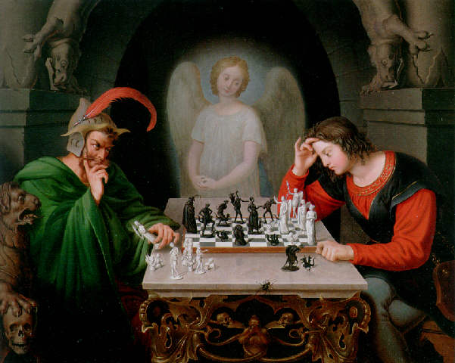
The Chess Player by Retzsch
Indolence
Pride
Falsehood
Pleasure
Unbelief
Faith
King
Truth
Peace
Hope
Prayers
Doubt
Humility
Anger
Innocence
Affection

Slide 14
The Chess Player by Retzsch
Laws of nature
Universe
Phenomena

Slide 15
What are the laws of nature?
It has been said that I speak of natural selection as an active power or Deity; but who objects to an author speaking of the attraction of gravity as ruling the movements of the planets? … I mean by Nature, only the aggregate action and product of many natural laws, and by laws the sequence of events as ascertained by us.
The Origin of Species, Charles Darwin

Slide 16
What are the laws of nature?
How much does Huxley include under the laws of nature(Para.16)?
Things and their forces;
Men and their ways;
Shaping our will into the desire of behaving in accordance with those laws.

Slide 17
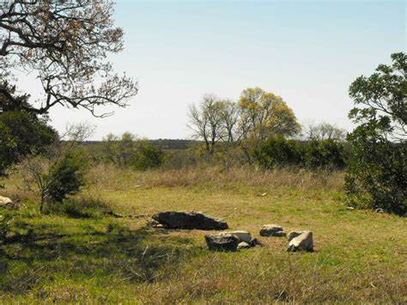
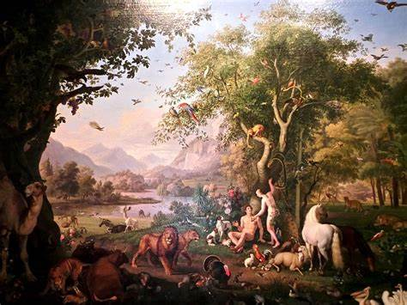

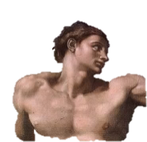

Why?
Para.17
Para.18-19
Para.20-21
Natural phenomena
Social & moral phe.
Nature’s univ.
Touch – Pain
Hearing
Sight
Ign. disob. incap.
Pain
Pleasure
Joy
Woe
Pleas.
Resp. obey
i. Having few accomplishment;
ii. Conduct being fashioned by obser-vation of others;
iii. Nature’s blow being deadly.

Slide 18
Group Discussion

Slide 19
The evolution of English
…that his body is the ready servant of his will…
…as a mechanism, logic engine, steam engine, gossamers, anchors…
One who, no stunted ascetic, is full of life and fire…
No leisure and enjoyment, but only activity serves to increase the glory of God. Waste of time is thus the first and in principle the deadliest of sins. Loss of time through sociability, idle talk, luxury, even more sleep than is necessary for health, six to at most eight hours, is worthy of moral condemnation.(Max Weber)

Slide 20
The evolution of English
These members of the minority, with whom I confess I have a good deal of sympathy…
syn + pathos
Together + suffering, painful feelings
Modes of persuasion
Ethos, pathos, logos
Moral character, habitual character, disposition
Statement, discourse, dialogue
credibility
Logic

Slide 21
The evolution of English
Subjunctive mood
Independent clause
I wish I were a bird.
I suggest/demand/resist that we do.
Conditional sentences
General truth: If people smoke, their health suffers.
A likely outcome: If you rest, you will feel better.
A very unlikely outcome, unrealistic
If I were you, I would marry her.
If I won lottery, I would give you half.
Contrary to/Different from the fact

Slide 22
The evolution of English
Subjunctive has no -s as the ending of the present tense.
Heaven rest her soul!
Long die thy soul!
Be it dynamic or static…
Whether it be academic, or related to art…
If it be Sunday…
Be he as old as he may.(Para.19)
= Whether he be young or old.

Slide 23
The evolution of English
Usage of “as”
…and that it is as true now, as it ever was…(Para.3)
The old protectionist theory is the doctrine of trades unions as applied by the squires.(Para.5)
…whether the most completely educated men are not as open to reproach on this score as the workmen.(Para.6)
…with as little reference to the needs of after-life in the case of a man as in that of the racer.

Slide 24
The evolution of English
Gargantua & Pantagruel《巨人传》
Translation version of 17thC by Urquhart Thomas
Chapter IX The Colours and Liveries of Gargantua
Gargantua’s colours were white and blew, as I have shewed you before, by which his father would give us to understand, that his sonne to him was a heavenly joy, for the white did signifie gladness, pleasure, delight, and rejoycing, and the blew, celestial things…What is it that induceth you? what stirs you up to believe, or who told you that white signifieth faith, and blew, constancy?

